Slide 1
Belleville Henderson CSD
2025-2026 Athletics

Slide 2
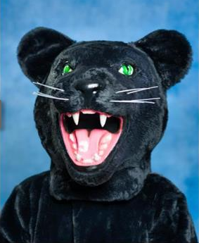
Meet our Mascot
“POUNCE” the Panther

Slide 3
Overview of Athletic Programs
FALL
Modified Soccer
Varsity Soccer
WINTER
Modified Basketball
JV Basketball
Varsity Basketball
SPRING
Modified Baseball
Modified Softball
Varsity Baseball
Varsity Softball

Slide 4
Athletics Budget Summary
Description | Projected 2023-2024 | Projected 2024-2025 | Proposed 2025-2026 | Budgetary Change (24-25)(25-26)
Athletics-Salaries | $96,099 | $93,923 | $95,000 | $1,077
Athletics-NI Salaries | $0 | $0 | $13,680 | $13,680
Athletics-Equipment Goals/Pitching Machine | $8,000 | $14,000 | $3,700 | ($10,300)
Athletics-Contractual- Dues/Awards/Registration Fees/Officials | $52,933 | $54,404 | $34,000 | ($20,404)
Athletics-Materials & Supplies – Uniforms/Balls/ Rulebooks | $25,697 | $33,072 | $35,000 | $1,928
Total | $182,729 | $195,399 | $181,380 | ($14,019)
2024-2025: $195,399 2025-2026: $181,380 Decrease: ($14,019)

Slide 5
Athletics BOCES Budget Summary
Description | Projected 2023-2024 | Projected 2024-2025 | Proposed 2025-2026 | Budgetary Change (24-25)(25-26)
Inter Scholastic Sports Coordination | $1,060 | $2,588 | $2,588 | $0
Assess, Award, Assignors & Officials | $4,245 | $4,000 | $4,000 | $0
Coord/Inter Athletics (OCM) | $3,256 | $3,296 | $3,296 | $0
Total | $8,561 | $9,884 | $9,884 | $0
2024-2025: $9,884 2025-2026: $9,884 Increase/Decrease: $0

Slide 6
Athletics Total Budget Summary
2024-2025: $205,283 2025-2026: $191,264 Decrease: ($14,019)

